Slide 1


PROXIMITY
AND PERMEABILITY
REVISITED
PRAGUE 18 – 21 MARCH 2026
URBAN INTERACTIONS REVISITED
20th AESOP YOUNG ACADEMICS CONFERENCE
Use this template
for contribution within given track

Slide 2

FLOWS
AND CONNECTIONS
REVISITED
PRAGUE 18 – 21 MARCH 2026
URBAN INTERACTIONS REVISITED
20th AESOP YOUNG ACADEMICS CONFERENCE
Use this template
for contribution within given track

Slide 3
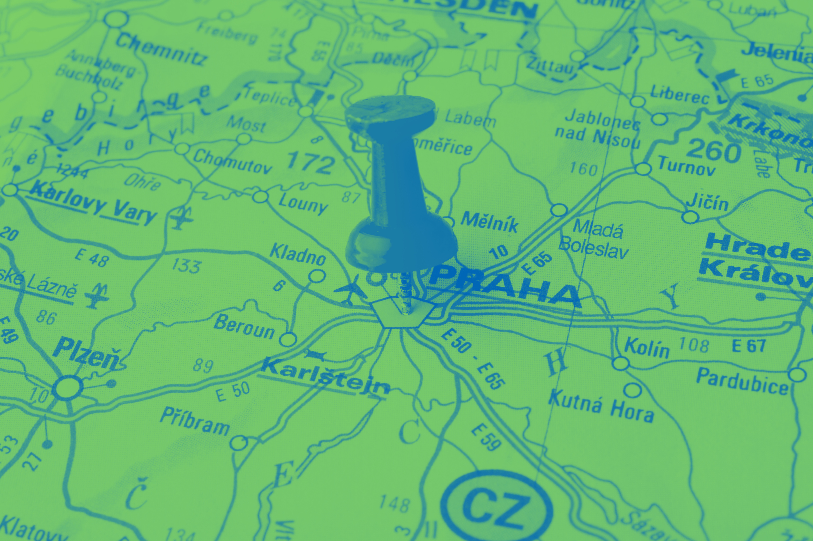
GOVERNANCE
AND TOOLS
REVISITED
PRAGUE 18 – 21 MARCH 2026
URBAN INTERACTIONS REVISITED
20th AESOP YOUNG ACADEMICS CONFERENCE
Use this template
for contribution within given track

Slide 4

INCLUSION
AND DYNAMICS
REVISITED
PRAGUE 18 – 21 MARCH 2026
URBAN INTERACTIONS REVISITED
20th AESOP YOUNG ACADEMICS CONFERENCE
Use this template
for contribution within given track

Slide 5
UNIVERSAL
TITLE
TEMPLATE
PRAGUE 18 – 21 MARCH 2026
URBAN INTERACTIONS REVISITED
20th AESOP YOUNG ACADEMICS CONFERENCE
Use this template freely
across all tracks

Slide 6
URBAN INTERACTIONS REVISITED
20th AESOP YOUNG ACADEMICS CONFERENCE
PRAGUE 18 - 21 MARCH 2026

